Slide 1
E- Resources (for Section A and Section G, Semester 6)
Week 2

Slide 2
Note for Students
Dear Students
I am sending you these e resources on the topics I wanted to cover during the present week. Please use these along with voice memos I have shared in your class group.
There is an assignment also. A case study will also be put on the class group. Submission details will be put on the same through CR.
You are free to contact me over the medium of your choice. Stay quarantined and safe.
Best wishes
Aruna Jha

Slide 3
Topics Covered
Shareholder Activism
Corporate Governance in PSUs
Corporate Funding of Political parties

Slide 4
Shareholder Activism

Slide 5
Reference :Taxmann Auditing and Corporate Governance for B.Com (H) by ARUNA JHA Edition 2020

Slide 6
Reference :Taxmann Auditing and Corporate Governance for B.Com (H) by ARUNA JHA Edition 2020

Slide 7
Reference :Taxmann Auditing and Corporate Governance for B.Com (H) by ARUNA JHA Edition 2020

Slide 8
Reference :Taxmann Auditing and Corporate Governance for B.Com (H) by ARUNA JHA Edition 2020

Slide 9
Reference :Taxmann Auditing and Corporate Governance for B.Com (H) by ARUNA JHA Edition 2020

Slide 10
Corporate Governance in PSUs or SOEs

Slide 11
Contribution of PSUs
https://www.dnb.co.in/events/PSU-Awards/awards.aspx

Slide 12
Corporate Governance at PSUs

Slide 13
Regulatory Framework
Corporate governance norms for PSUs emanate from the
The Companies Act, 2013;
SEBI (Listing Obligation and Disclosures Requirement) Regulations, 2015 and
CPSE Guidelines issued by the Department of Public Enterprises under the Ministry of Heavy Industries and Public Enterprises.

Slide 14
Issues in Corporate Governance
Autonomy of the Board
Ownership Policy
Appointment of Directors
Non-compliance
Excessive regulations
Reference :Taxmann Auditing and Corporate Governance for B.Com (H) by ARUNA JHA Edition 2020

Slide 15
Ways to Improve Corporate Governance
According to World Bank Study entitled, “Corporate Governance of Central Public-Sector Enterprises”, 2010)

Slide 16
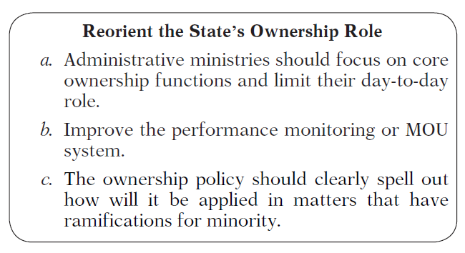
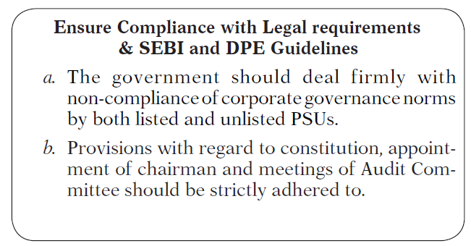
Ways to Improve Corporate Governance

Slide 17
Corporate Funding of Political Parties

Slide 18
Corporate funding of political parties
Assignment
Compare and contrast the practise of Corporate Funding of Political Parties in US and India.You may find the following links useful besides chapter on the same from your text book:
https://economictimes.indiatimes.com/news/politics-and-nation/view-the-real-problem-with-electoral-bonds/articleshow/72187122.cms?from=mdr
https://corporate.exxonmobil.com/Company/Policy/Political-contributions-and-lobbying
https://investors.coca-colacompany.com/corporate-governance/political-engagement-policy
https://www.livemint.com/politics/policy/electoral-bonds-boon-or-bane-for-india-s-political-funding-system-11575424422379.html

Slide 19
Corporate funding of political parties
https://www.business-standard.com/article/economy-policy/data-shows-bjp-bagged-92-of-corporate-donations-to-political-parties-119011701405_1.html
https://www.bloombergquint.com/business/most-of-indias-top-50-listed-firms-stayed-away-from-political-funding
https://www.orfonline.org/wp-content/uploads/2014/03/IssueBrief_69.pdf
https://vakilsearch.com/advice/corporate-funding-elections/

